Slide 1


MAWLANA BHASHANI SCIENCE AND TECHNOLOGY UNIVERSITY
SANTOSH, TANGAIL-1902
DEPARTMENT OF INFORMATION AND COMMUNICATION TECHNOLOGY
PRESENTATION ON
CAMPUS LOST & FOUND
MANAGEMENT SYSTEM
Web Application Development Lab • ICT-3204
SUBMITTED BY
SUBMITTED TO
Apurba Chandra Roy
Md. Anwar Kabir
ID: IT-23031 | 3rd Year, 2nd Semester
Session: 2022-2023
Dept. of ICT, MBSTU
Lecturer,
Department of ICT, MBSTU
Performance: 23-09-2026
Submission: 09-10-2026

Slide 2
Project Idea & Motivation
PROJECT IDEA
MOTIVATION
Lost-item information is often shared informally through friends, groups or notice boards. This system provides a structured place for reporting, searching and managing claims inside the campus community.
A centralized web platform where students can report lost or found items, browse available posts, view item details and submit claim requests.
Turn an m\\Report → Search → View → Claim → Admin Decision database-driven web application.
02

Slide 3
Project Objectives
1
Provide an online platform for reporting lost and found items.
2
Allow students to search and filter available item posts.
3
Enable users to submit claim requests for items.
4
Store users, items and claims in a MySQL database.
5
Provide an admin panel for monitoring and managing the system.
6
Demonstrate front-end, back-end, authentication and database integration.
Outcome: a complete multi-page PHP + MySQL web application with user and admin roles.
04

Slide 4
Problem Statement
1
Scattered information
2
Difficult discovery
Lost/found notices may be spread across informal channels.
Students may not know where to search for a particular item.
3
Weak verification
4
No central control
A claim needs a clear message and an accountable workflow.
There is no single place to monitor users, items and claims.
Goal → provide one simple, searchable and manageable platform for the campus community.
03

Slide 5
Key Features
01
02
03
04
Registration & Login
Lost / Found Posts
Search & Filter
Item Details
Create an account, authenticate and maintain sessions.
Create posts with title, description, category, location, date and image.
Search by title/category/location and filter by item type.
View complete item information and poster details.
05
06
07
08
Claim Requests
My Posts & Profile
Admin Dashboard
User / Item / Claim Management
Send a claim message for an item.
Manage own posts and update profile information.
View system-level counts and administrative sections.
Admin can review users, items and approve/reject claims.
05

Slide 6
User Roles & Access
USER / STUDENT
ADMIN
Regular user capabilities
Administrative capabilities
• Register and log in
• Post lost or found items
• Browse, search and filter items
• View item details
• Submit claim requests
• Manage own posts
• Update profile
• Access admin dashboard
• View registered users
• Monitor all item posts
• Review claim requests
• Approve or reject claims
06

Slide 7
Technology Used
Frontend
Backend
Data base
Local Development
HTML5
CSS3
JavaScript
PHP
Session Authentication
MySQL
Relational Tables
XAMPP
Apache + MySQL
Editor
Version Control
Deployment
Visual Studio Code
Git + GitHub
Infinity Free
PHP + MySQL Hosting
Architecture style: client-side UI → PHP server logic → MySQL database.
07

Slide 8
System Architecture
USER / ADMIN
→
FRONT-END
→
PHP BACKEND
→
MYSQL
Browser
Web UI
HTML • CSS • JavaScript
Authentication
CRUD • Claim Logic
users • items • claims
User action → PHP validation/session → MySQL query → server response → updated webpage
08

Slide 9
Database Design
users
items
claims
• id (PK)
• name
• email
• password
• role
• id (PK)
• user_id (FK)
• title
• description
• type / category
• location / date
• image / status
• id (PK)
• item_id (FK)
• user_id (FK)
• message
• status
• created_at
Primary keys identify records; foreign keys connect users, item posts and claim requests.
09

Slide 10
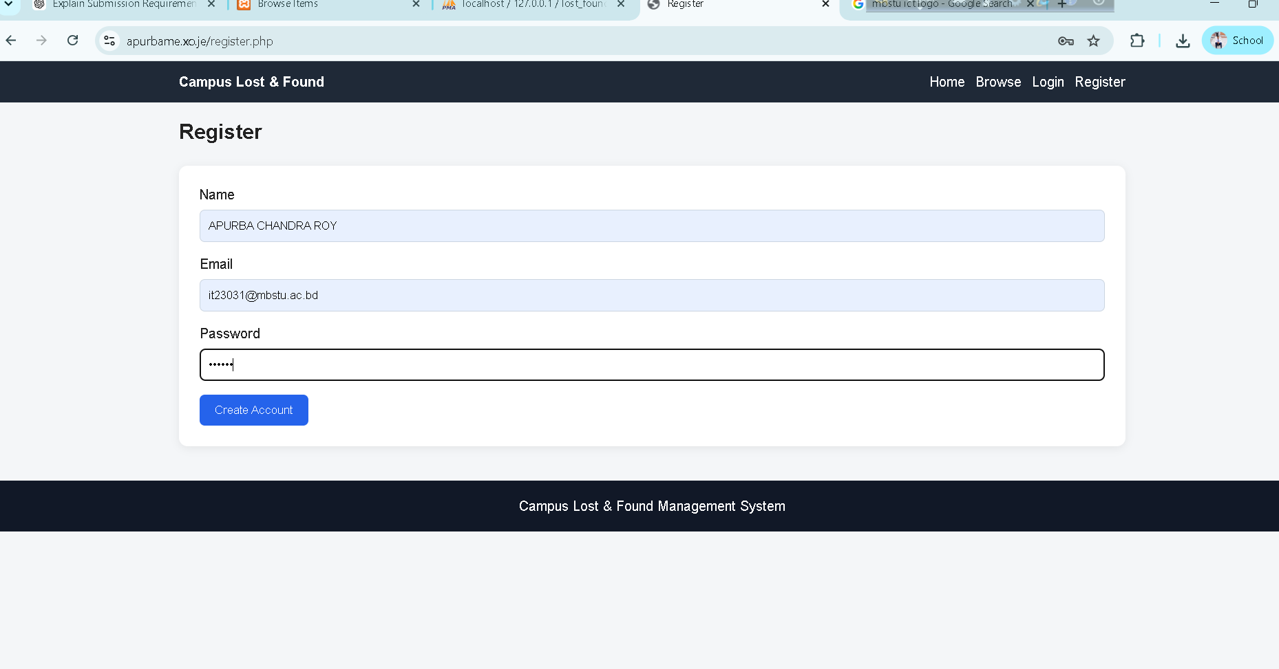
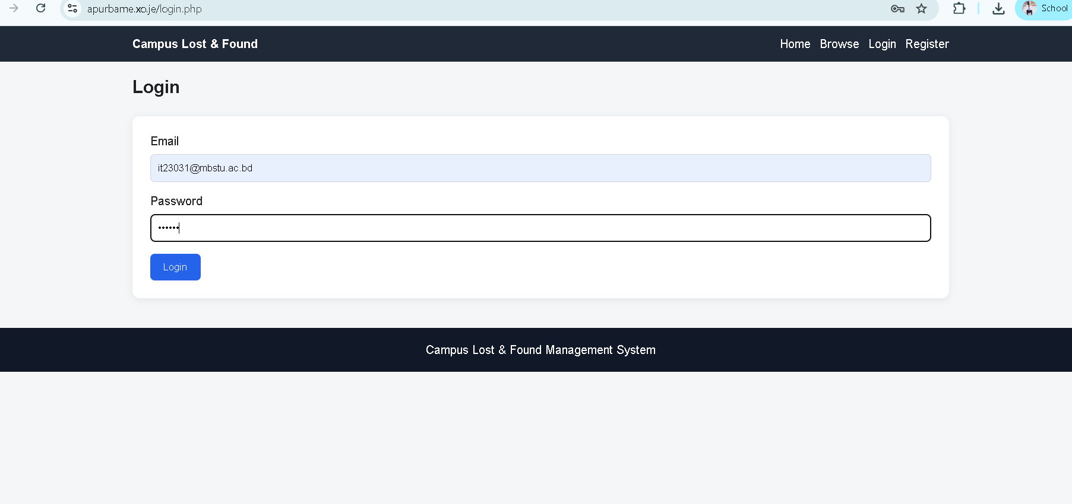
Important UI Screens — Registration & Login
REGISTRATION
LOGIN
10

Slide 11
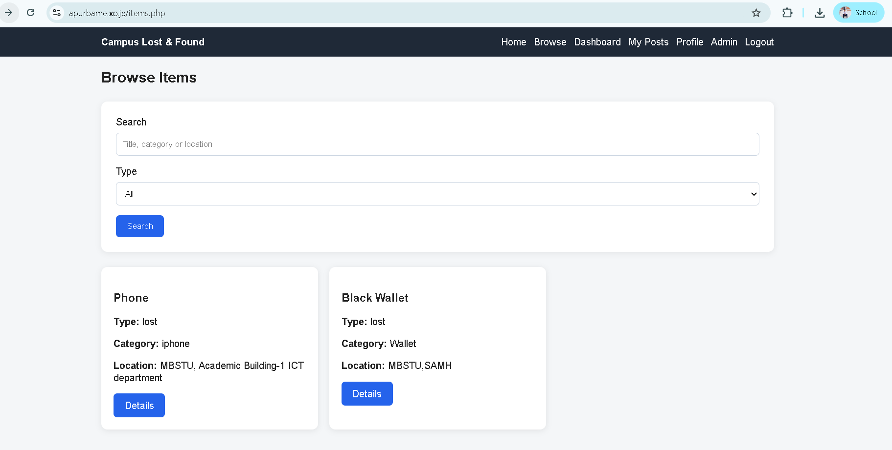
Important UI Screens — Report & Browse
Report & Browse / Search
11

Slide 12
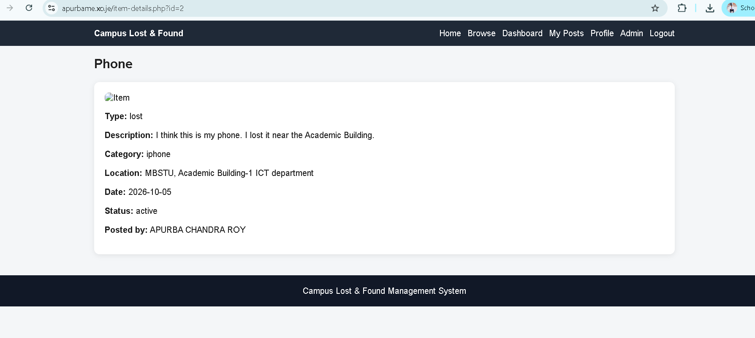
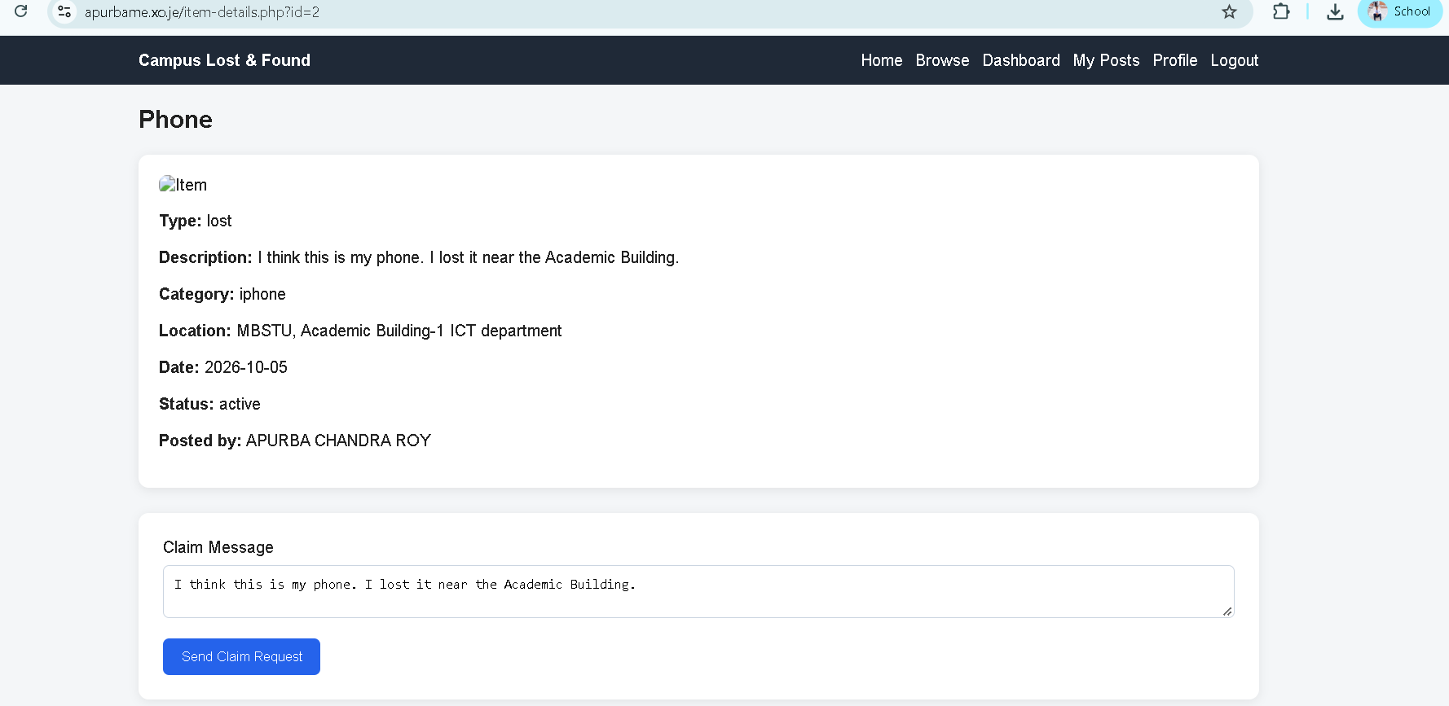
Important UI Screens — Item Details & Claim
ITEM DETAILS
CLAIM REQUEST
12

Slide 13
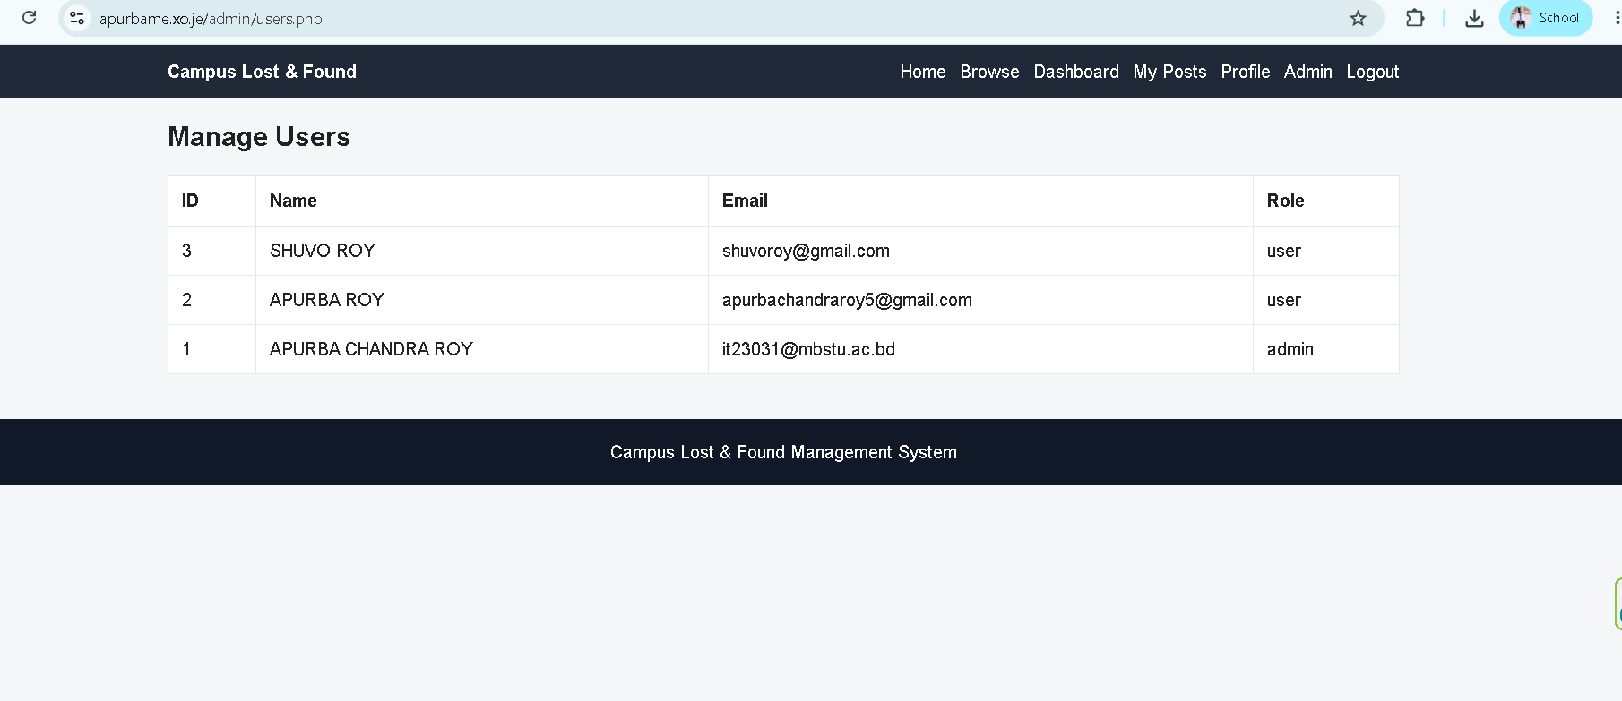
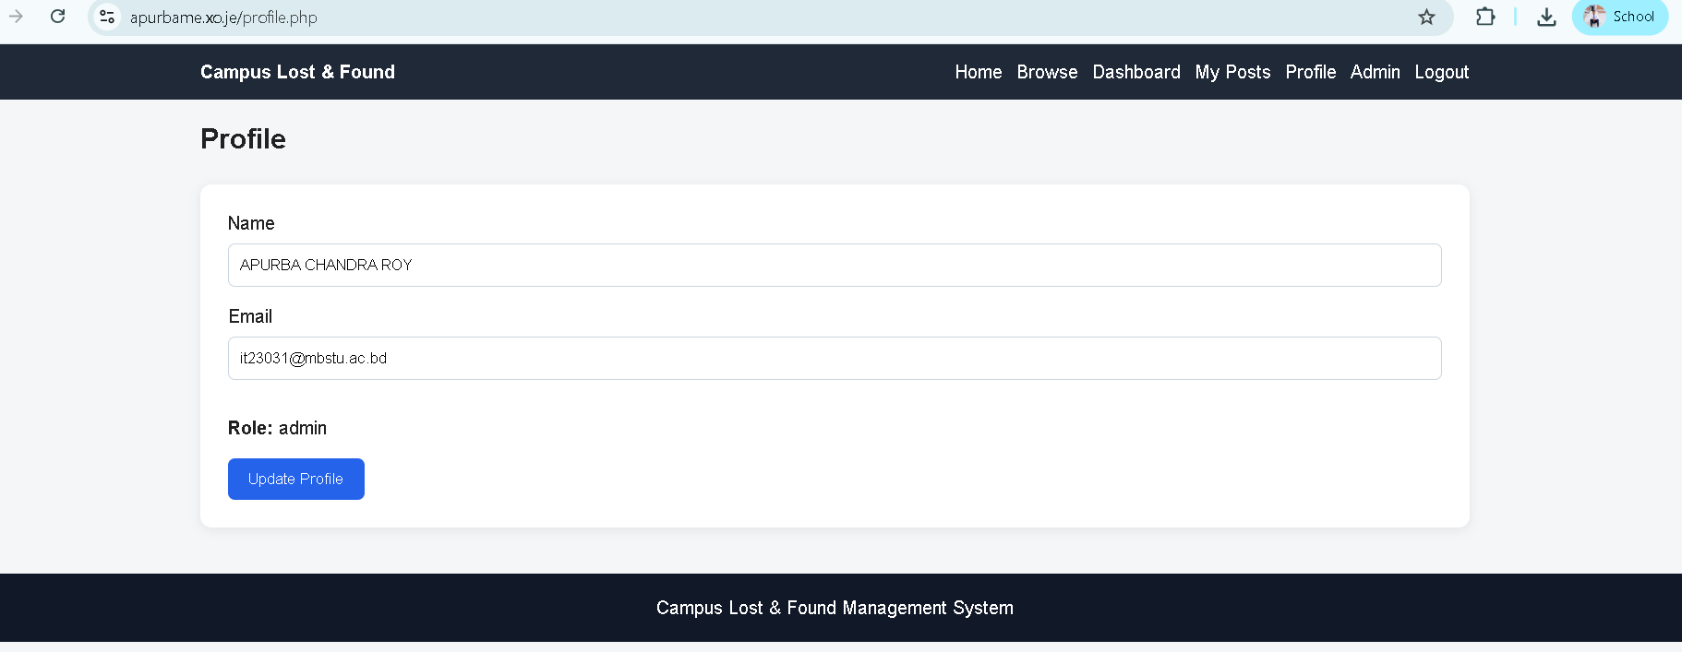
Important UI Screens — Administration & Profile
ADMIN — MANAGE USERS
USER PROFILE
13

Slide 14
Project Demonstration
1
Register / Login
2
Post Item
3
Browse
User creates account and signs in.
User submits a lost/found item.
Another user searches and opens item details.
4
Claim
5
Admin Review
6
Decision
User sends a claim message.
Admin sees the request in Manage Claims.
Admin approves or rejects the request.
Tested on the live deployment: registration → login → lost item → details → claim → admin approval.
14

Slide 15
Implementation & Test Results
Registration
Successful
User record stored in MySQL.
Login / Session
Successful
Authenticated user reaches dashboard.
Lost Item Post
Successful
Item appears in Browse and Details.
Claim Request
Successful
Claim appears for admin review.
Admin Approval
Successful
Admin can approve/reject claim.
Search / Browse
Successful
Items can be discovered and filtered.
Result: the main user and admin workflow was successfully exercised on the deployed website.
15

Slide 16
GitHub & Live Website
GITHUB REPOSITORY
LIVE WEBSITE
Campus-Lost-Found-
Management-System
Campus Lost & Found
Deployed on Infinity Free with PHP + MySQL.
Public repository containing the PHP source code, CSS, JavaScript, admin pages, configuration structure and README.
https://github.com/apurbaroyy/Campus-Lost-Found-Management-System
https://apurbame.xo.je/index.php
16

Slide 17
Challenges, Security & Future Improvements
CHALLENGES & SOLUTIONS
SECURITY MEASURES
FUTURE IMPROVEMENTS
• MySQL port conflict during local setup → resolved through XAMPP configuration.
• Hosting initially returned HTTP 500 → database credentials were corrected.
• Hosting database uses a prefixed database name → imported tables into the actual hosting database.
• Password hashing with password_hash().
• Password verification with password_verify().
• Session-based authentication and admin authorization.
• Prepared SQL statements for database operations.
• Email notifications for claim updates.
• Automatic item status update after successful claim.
• Improved image preview and management.
• Advanced search/filtering and possible mobile app integration.
17

Slide 18
ffffb
Conclusion
Campus Lost & Found Management System
FUTURE IMPROVEMENTS
A complete web application demonstrating registration, authentication,
CRUD operations, search/filtering, claims, role-based administration and MySQL integration.
Github Link : https://github.com/apurbaroyy/Campus-Lost-Found-Management-System
Live Link : https://apurbame.xo.je/index.php
17

